Slide 1
AD1 - Masterplan and Buildings
QPLANT + QINFRA

Slide 2
AD01 SCK CEN Auxiliary Buildings
Document Reference and Navigation

Slide 3
1. Masterplan

Slide 4
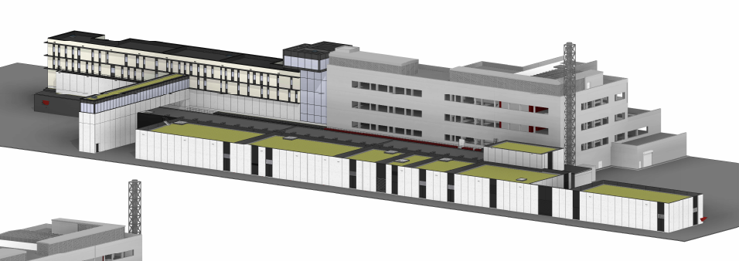
SCK CEN/83474410
Master Plan – MINERVA (buildings)

Slide 5
SCK CEN/83474410
Master Plan – MINERVA (buildings)
AUB
CCB + Outside

Slide 6
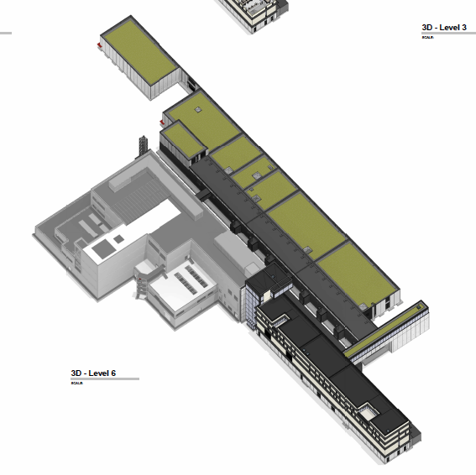
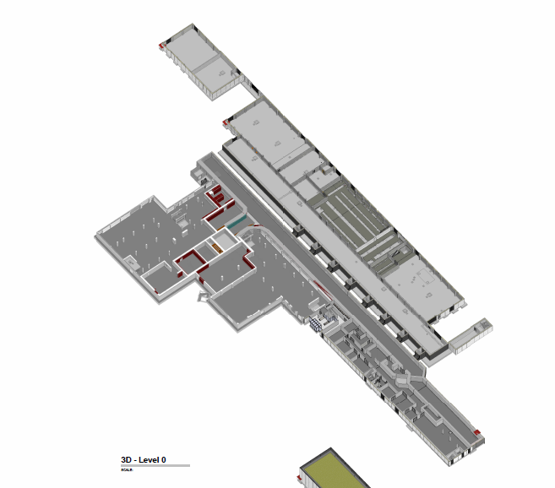
SCK CEN/83474410
Master Plan – MINERVA (buildings)
MYRRHA
Reactor
Phase 1

Slide 7
SCK CEN/83474410
Master Plan – MINERVA (buildings)
Level 0
CCB + Outside
MYRRHA
Reactor
Coldbox Room
Phase 1

Slide 8
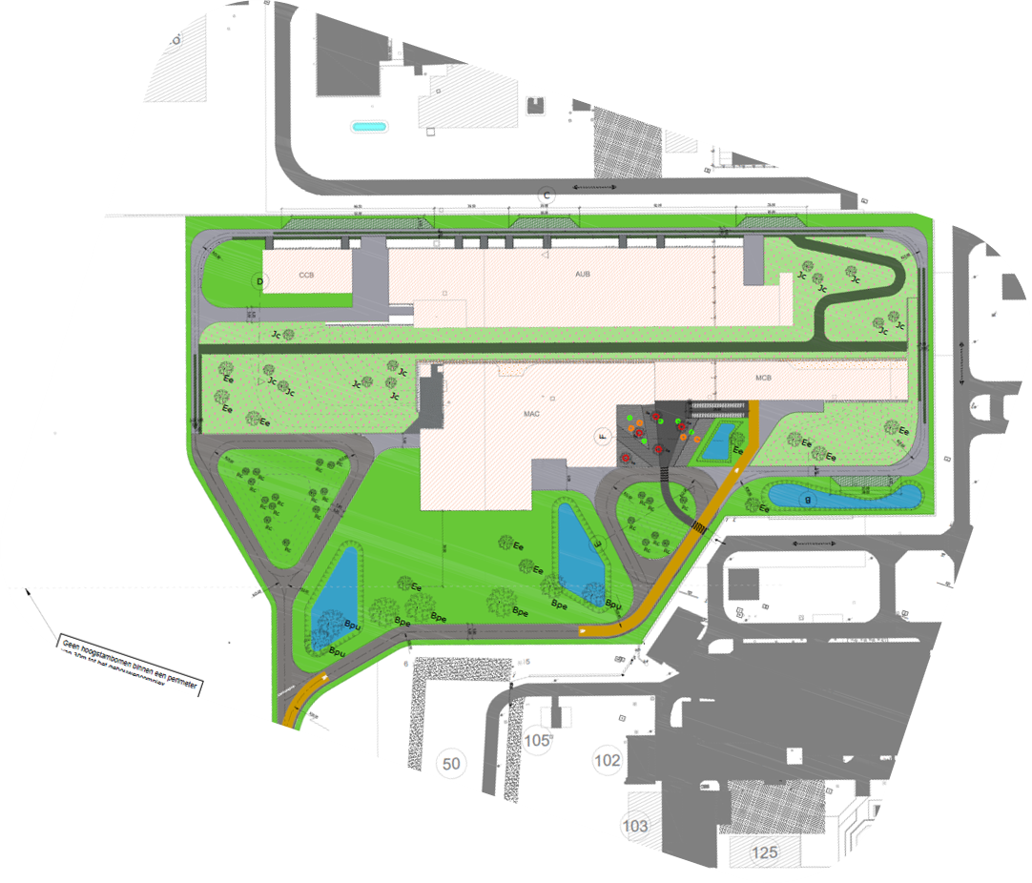
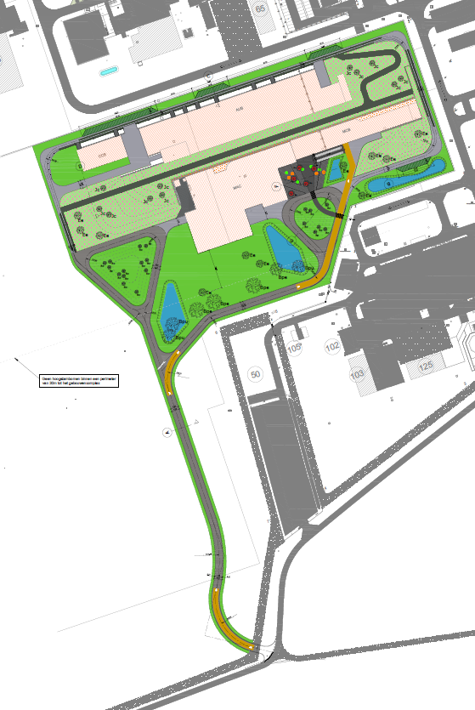
SCK CEN/84582975
Master Plan – MINERVA

Slide 9
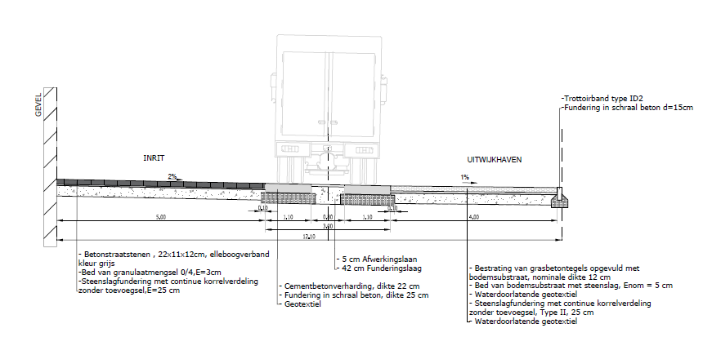
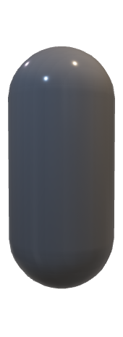
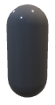



SCK CEN/81790617
Master Plan – MINERVA (buildings)
QRB
QRB
Transport Positioning
12 m available
QRB Move-in
Flatbed + Crane

Slide 10
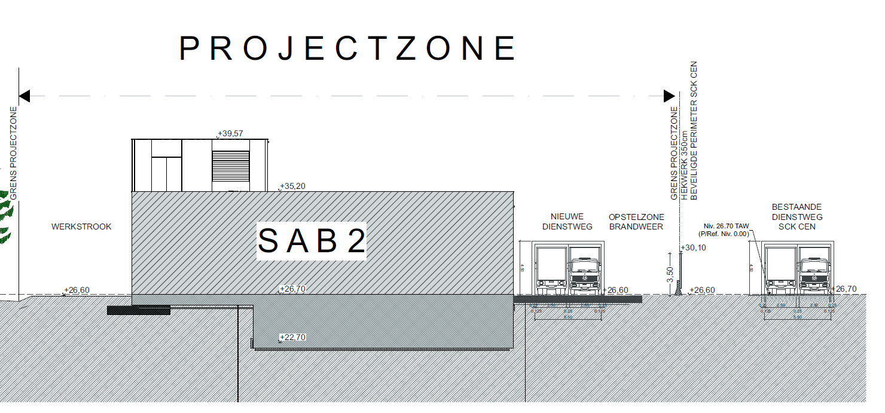
SCK CEN/81504499
Master Plan – MINERVA (buildings)
Equipment – Move from South Side

Slide 11
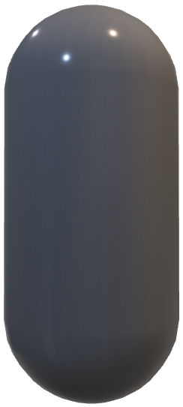
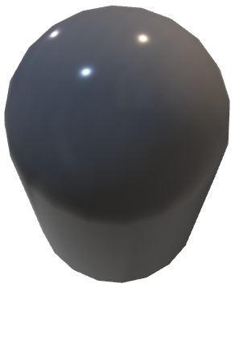
SCK CEN/81790617
Master Plan – MINERVA (buildings)
D = 3.5-4m
L = 11m
QRB

Slide 12
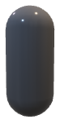
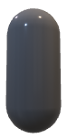
SCK CEN/81504499
Master Plan – MINERVA (buildings)
Unload from Flatbed
Rotate
NEED CRANE
Move Sideways
Move through Roof

Slide 13
Masterplan Requirements (ACC NF)
Space between SAB and MINERVA (south) perimeter fencing for unloading and move-in (QRB specific)
Access for/to crane for lifting of QRB
Present preference via Roof Access
Weight <= 100 ton (expected ~70 ton)
Access for/to crane for lifting of WGS
3 x 120 m³ gas storage vessels
Handling of instantaneous load on ground (QRB specific) – Road/Flat surfaces

Slide 14
Building Architecture

Slide 15
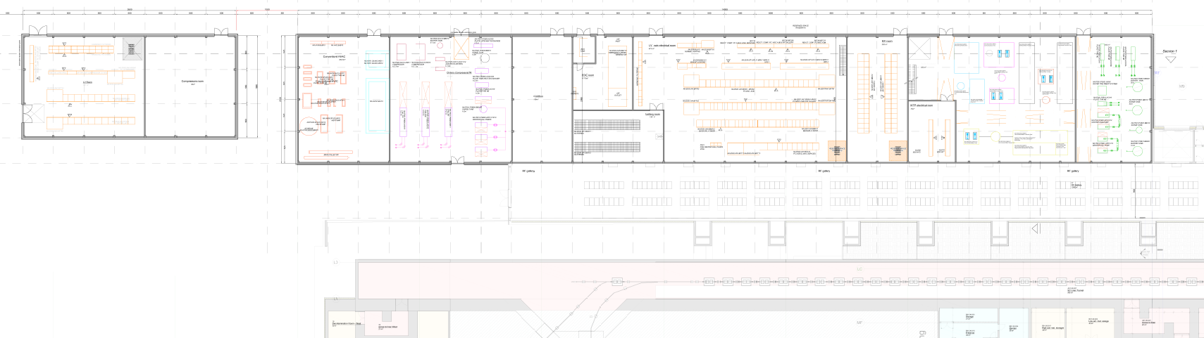
Nuclear Facilities (ACC NF)
AUB + CCB
Fixed Building dimensions!
CCB + Gas storage
Coldbox

Slide 16
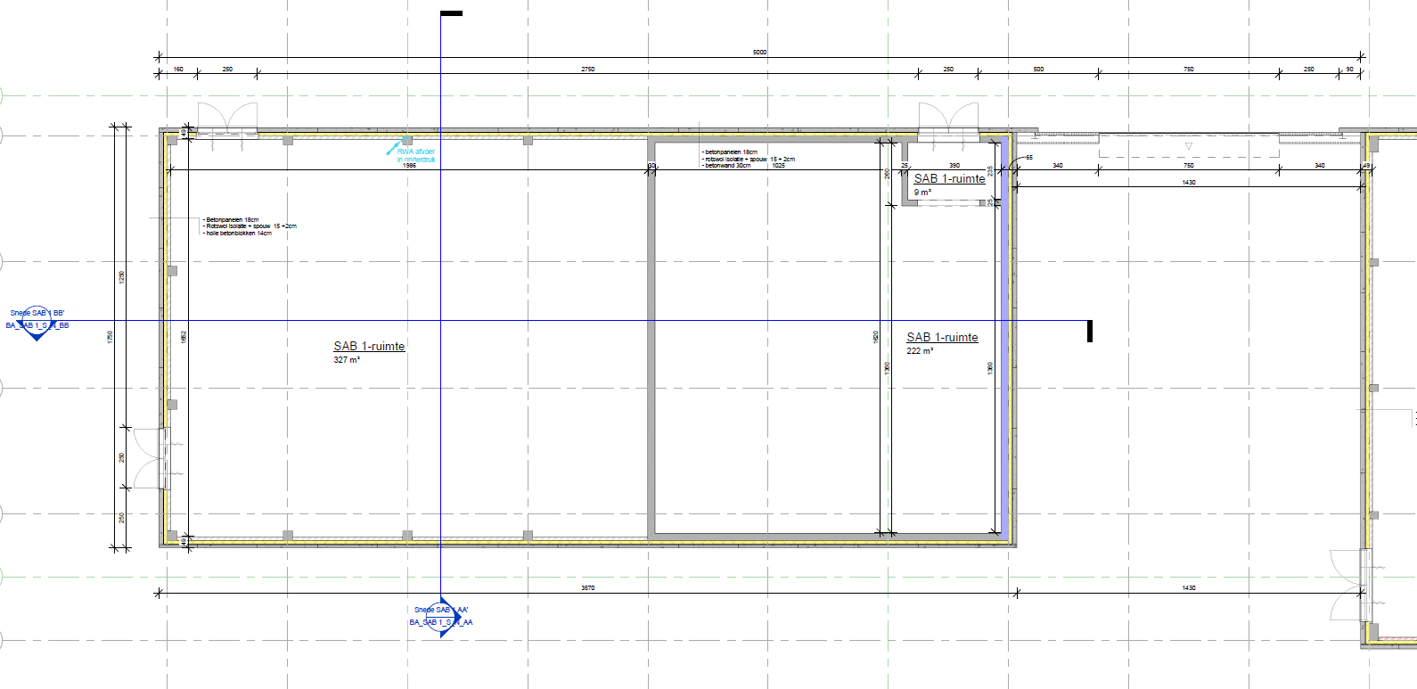
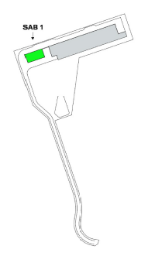
Separate Cryogenic Compressor Building
SCK CEN/81503739
CCB+Gas Storage
Building design ready for start of detailed-design-for-procurement

Slide 17
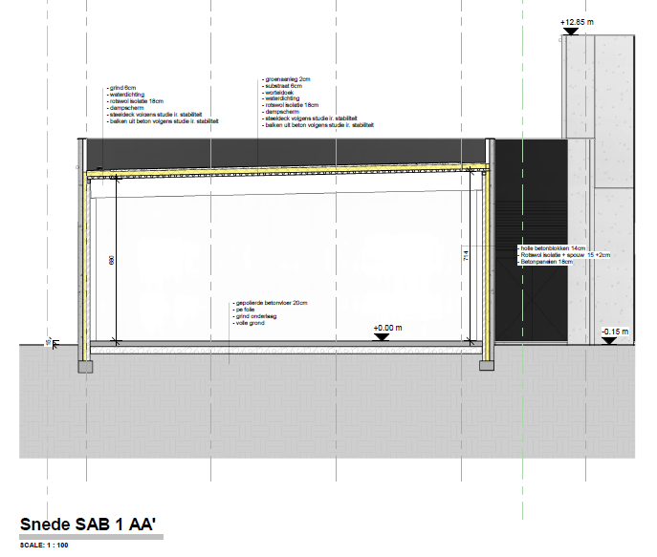
Nuclear Facilities (ACC NF)
SCK CEN/81505150
CCB Cros-section
Note Sloping Roof

Slide 18
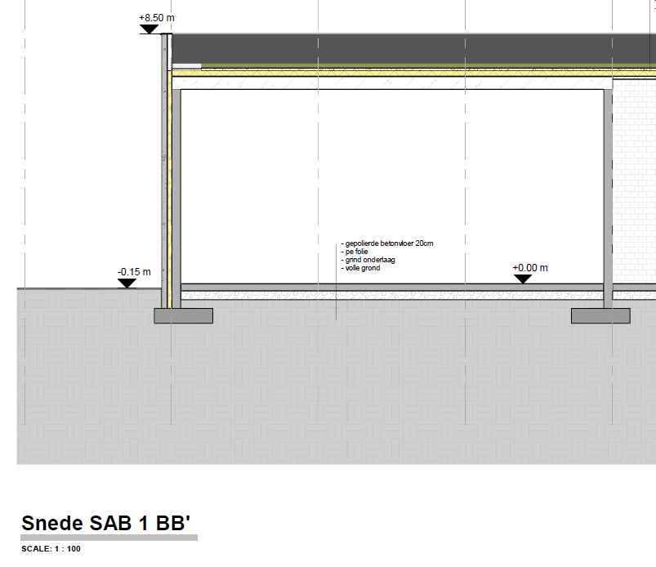
CCB
SCK CEN/81506075
CCB Cros-section
WCS
Dedicated Electrical Room for WCS

Slide 19
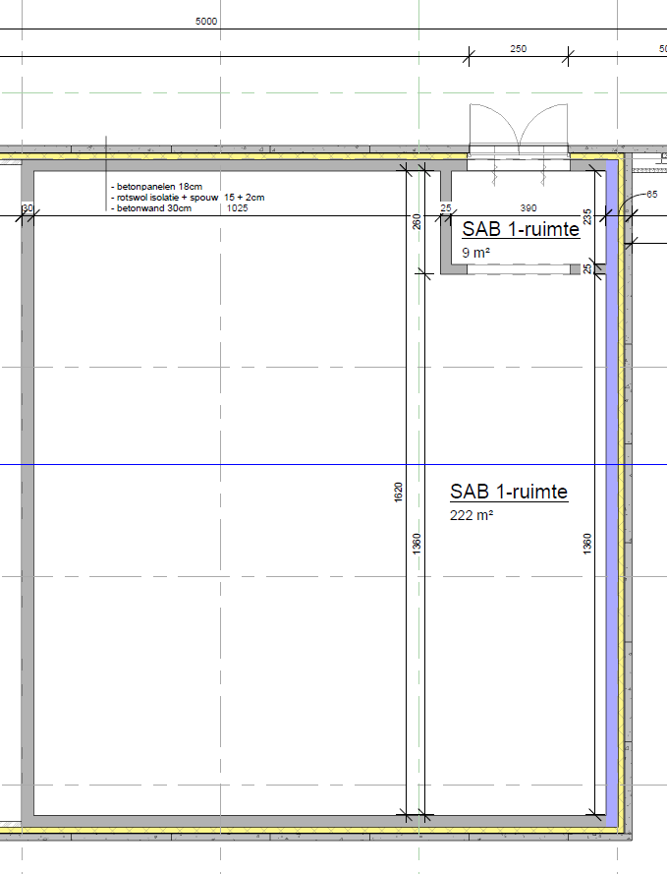
CCB
WCS – Room detail
Door Access for biggest equipment – HP compressor Skids
Noise Abatement (75 dB loudest equipment)
Design to prevent oil (oil lubricated compressors) contamination to outside
Individual drip pans for HP and PVPS TBD

Slide 20
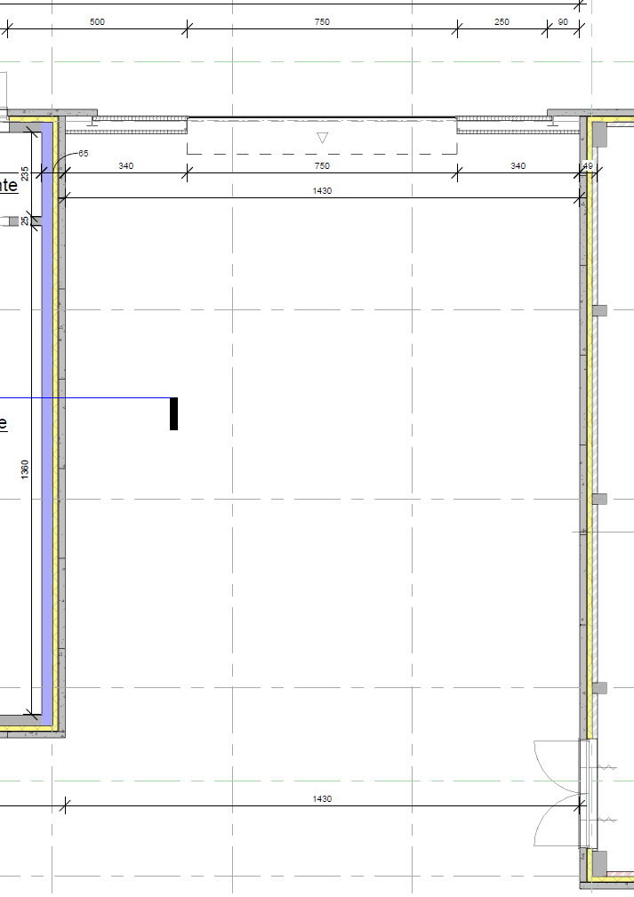
Nuclear Facilities (ACC NF)
Gas Storage (outside)
Space for 3x120 m³ Helium storage vessels (WGS)
Space for 1x30 ton Liquid Nitrogen and Evaporator (Not ACC NF scope
Access for truck inside and/or via wall connections

Slide 21
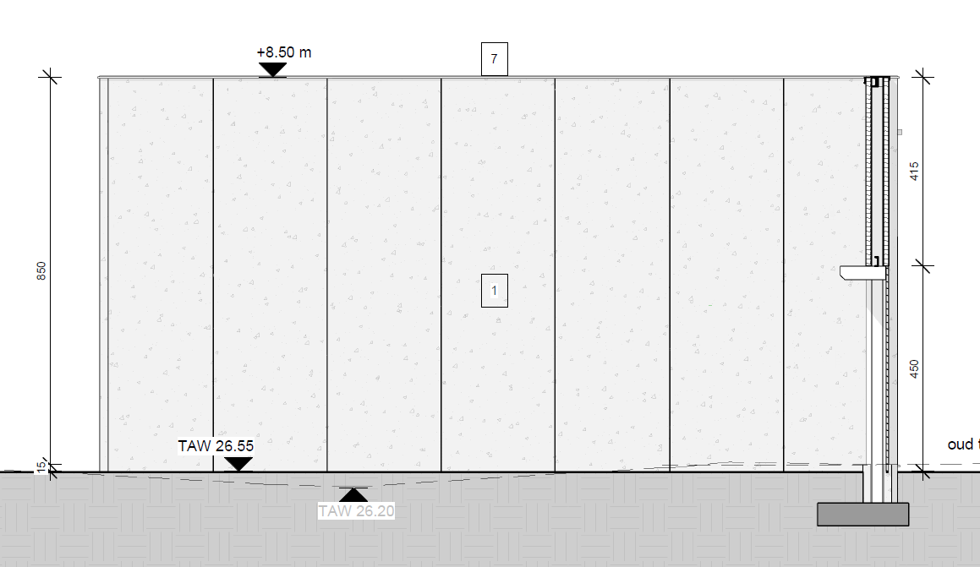
Nuclear Facilities (ACC NF)
SCK CEN/81506386
CCB Side View – East (towards WCS)
Area for Warm Piping Penetration – above 4.5 m access door. Specific location TBD

Slide 22
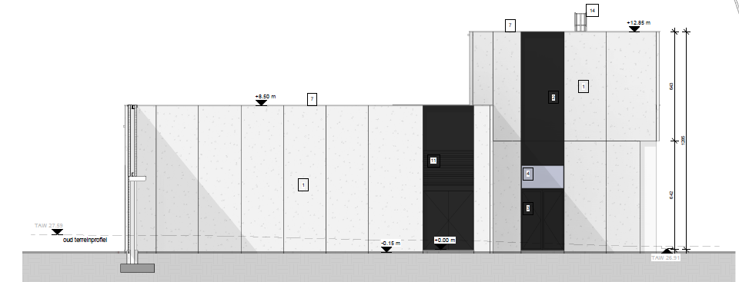
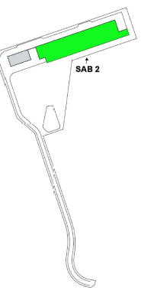
Nuclear Facilities (ACC NF)
SCK CEN/81505064
AUB Side View – West (towards QRB)
Area for Warm Piping Penetration – above 4.5 m access door. Specific location TBD

Slide 23
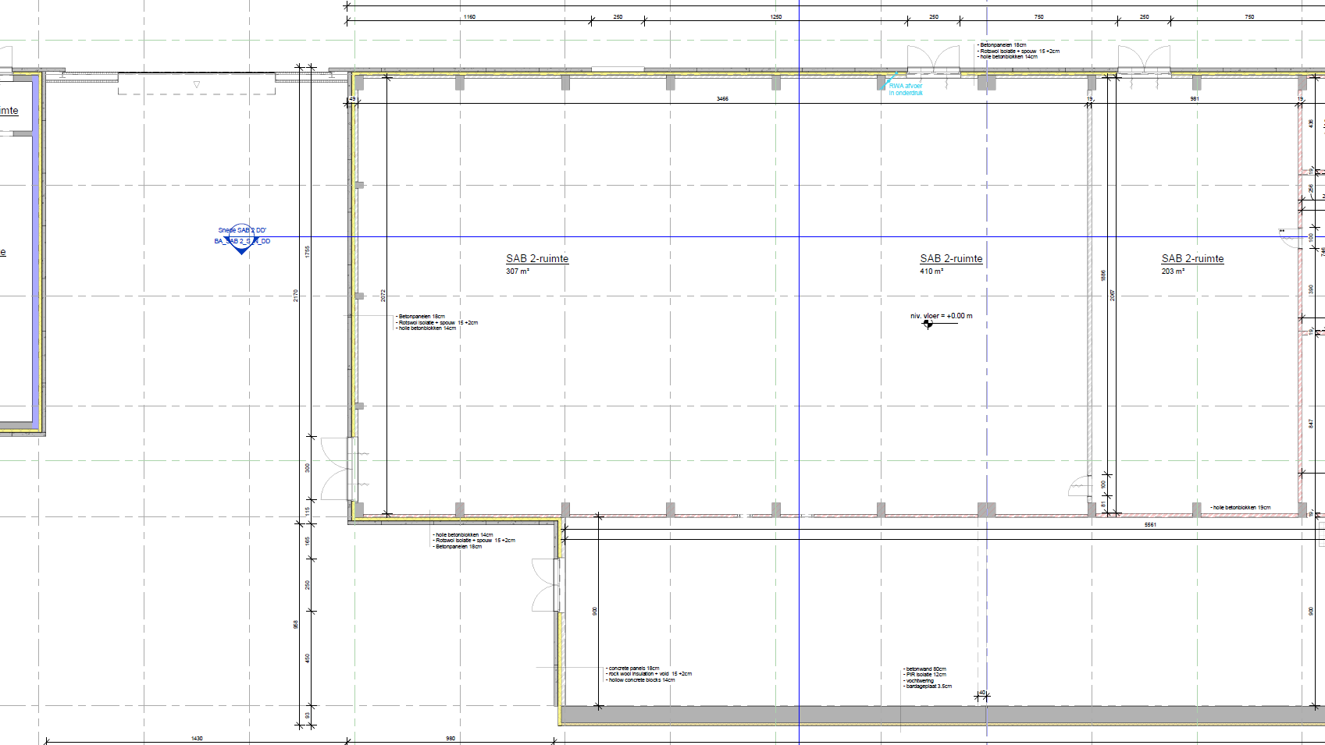
Separate Cryogenic Compressor Building
SCK CEN/81503739
Cold Box room in AUB

Slide 24
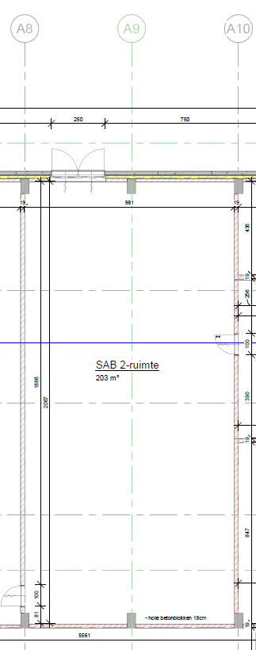
Separate Cryogenic Compressor Building
SCK CEN/81503739
Cold Box room in AUB
Space for Horisontal Coldbox
Need to avoid structural beams ~5 m apart
Possible routing of warm piping via roof
Preferred horizontal penetration
Access Door to small (2.5 m) for QRB move-in
Removal of single panel (~5m vertical considered)
Preferred option is rooftop access

Slide 25
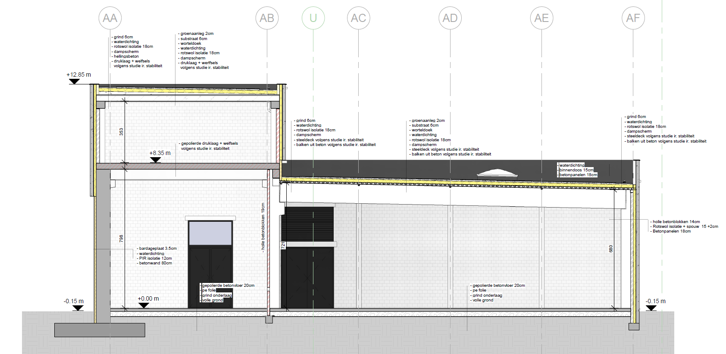
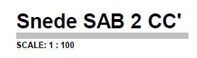
Nuclear Facilities (ACC NF)
SCK CEN/81504370
AUB Cros-section
Note Sloping Roof
Structural Support Roof (~5m apart)
QRB place between to maximize height

Slide 26
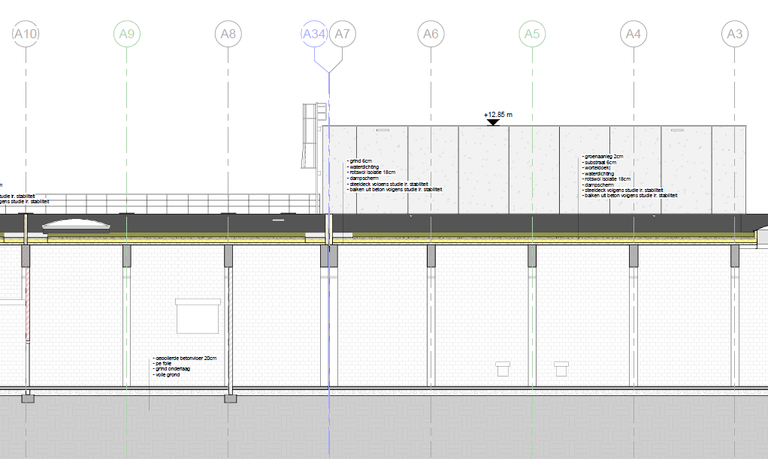
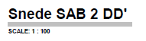
ColdBox Room
SCK CEN/81506075
AUB Cros-Section
Structural Support Roof (~5m apart)
Coldbox Room

Slide 27
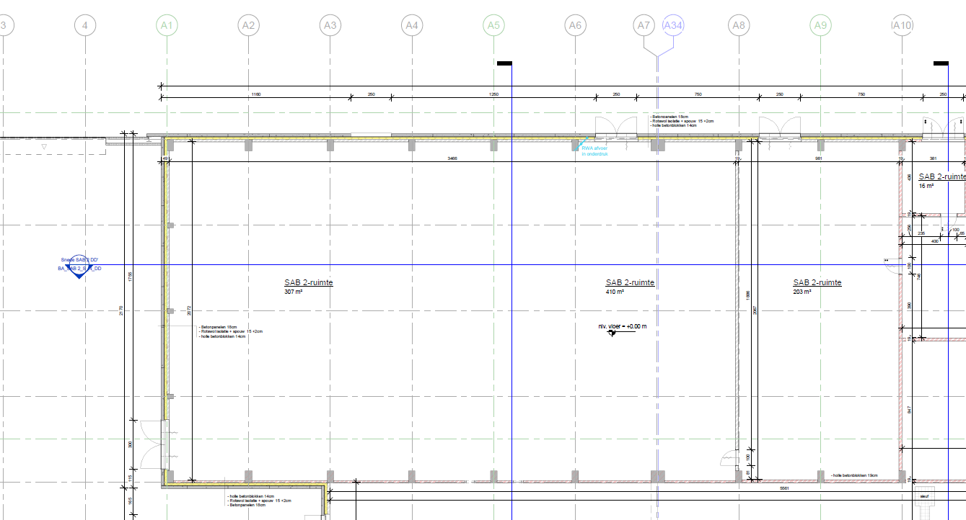
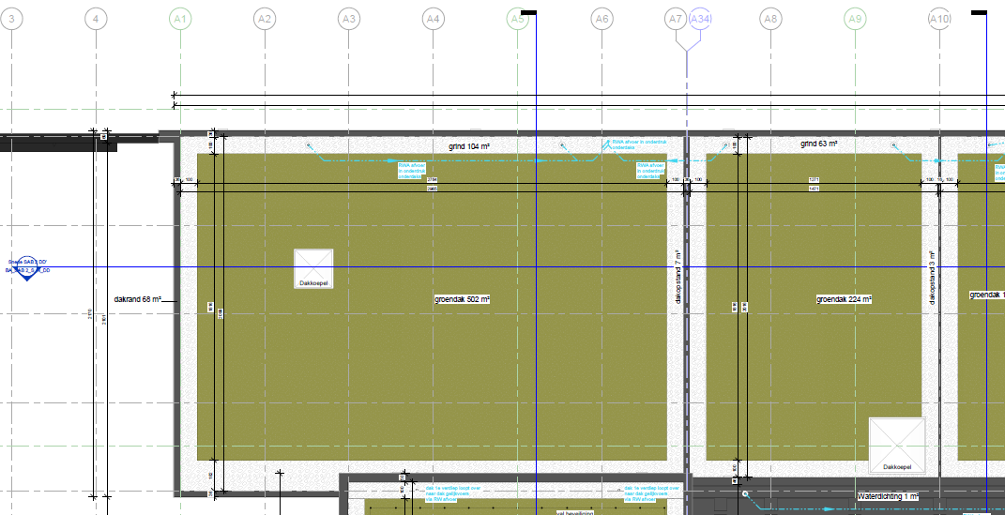
Separate Cryogenic Compressor Building
SCK CEN/81504187
Cold Box room in AUB
Ground Floor – Coldbox
Roof - Coldbox

Slide 28
WARM PIPE ROUTING
Cold Box room in AUB towards CCB
Through AUB routing (2 wall penetrations)
Via Roof (vertical penetration)
– more bends, avoid ACC NF SSC

Slide 29
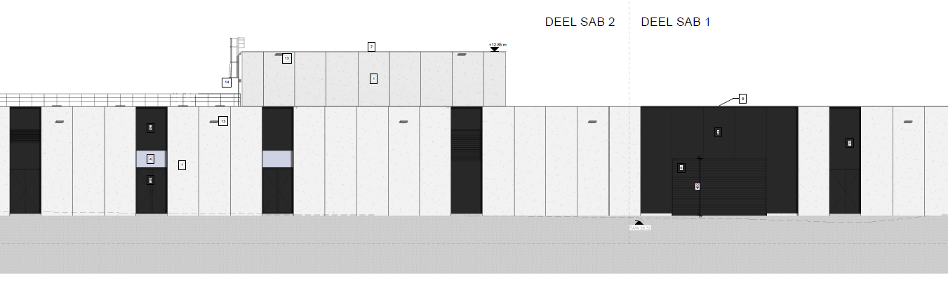
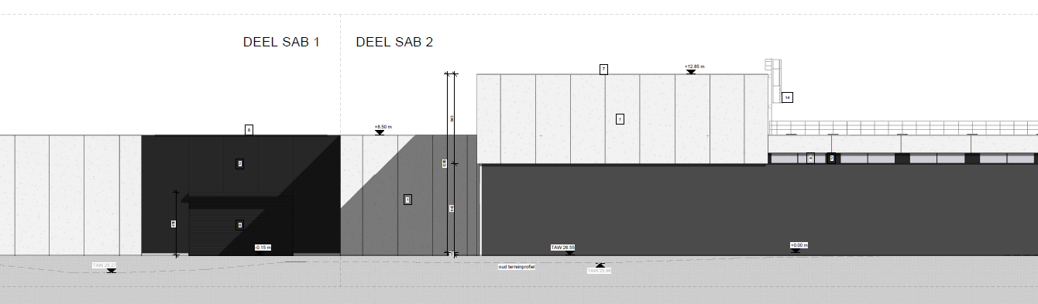
SCK CEN/81504188
SCK CEN/81506074
Master Plan – MINERVA (buildings)
North View
Equipment – Move from South Side
Cold Box Room
South View
From LTU via RF Gallery
Cold Box Room

Slide 30
Building Architecture Requirements
Fixed dimensions of CCB (WCS) and AUB (Coldbox Room)
Coldbox move-in via roof – BA coordination during installation
Routing of internal (scope of piping (AUB to CCB))
Penetrations and ‘routing path’ for QPLANT Contractor
Avoid ACC NF equipment and allow welding (15cm clearance for orbital welding)
Avoidance of oil spill and release to environment – CCB confinement
Additional noise mitigation – BA responsibility
Routing of QLR (from LTU to QRB)
Routing of additional warm piping
Same as main cryogenic distribution (LTU to QRB)

